Slide 1
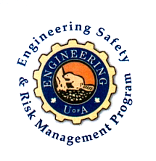
Fundamentals of RM
RM System and Process
Leadership in RM
Incident Investigation
RM Tools & Challenges
RM in Industry
People & Org.
Application and Perspectives
On Becoming a Leader
in Risk Management
ENGG404 - Lecture
Chapter 6.3:
The Business Case
for a Risk Management Program

Slide 2
Display this slide at the start of the lecture.
Request students to print this FORM or work on-line.
It is in the shared drive Student Resources / Handouts folder.
The ALE in this lecture is to explain and complete this form.
Notes:
2

Slide 3
Learning Outcomes:
Explain the difference between the cost of a risk management program and the cost of a loss incident, and the degrees of certainty of those costs.
Interpret a set of data and apply one method, the AIChE Model for a Business Case, to build the business case i.e. a favourable financial outcome for investing in a safety and risk management program.
Chapter 6.3: The Business Case for a Risk Management Program
3
Notes:
3

Slide 4
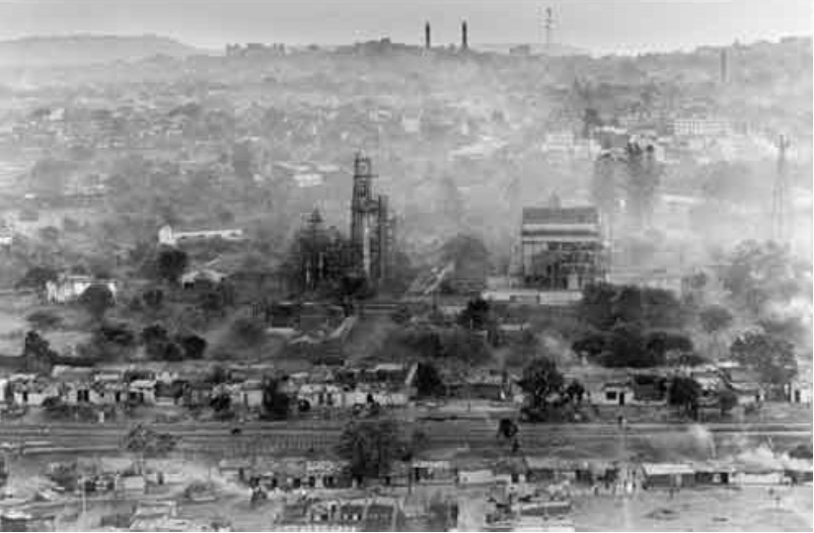
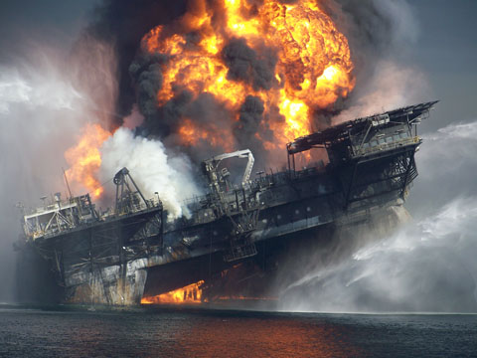

Introduction:
Loss avoidance is the same as maximizing profit!
Preventing major loss incidents are important for PEAP impacts:
Can impact many, many people,
May significantly impact the environment,
Costs can easily reach into the millions, hundreds of millions, and billions of dollars.
  Lost assets, costs for recovery, environmental clean-up, litigation cost of business interruptions, loss of customers, “social license to operate”, future business expansion, even the viability of the organization.
Although the likelihood of a process safety loss incident is
“low to extremely low”, but with severe consequences.
UCIL – Bhopal, India
Cost to avoid? Easily <$100 Million
Cost of Loss Incident: Billions $’s
BP-DWH – Gulf of Mexico, LA, USA
Cost to avoid? Easily <$100 Million
Cost of Loss Incident: Billions $’s
Your Team Project Loss Incident?
Chapter 6.3: The Business Case for a Risk Management Program
4
Notes:
4

Slide 5
Why Do We Need to Build a Business Case for a RM Program?
Economic Return:
The basic investment metric is the Return on Investment (ROI).
It is difficult to justify investment if the likelihood of an incident is extremely low or there are no incidents, and it is hard to show a return on investment in risk management.
Thus, too often companies look at risk management as a cost of doing business, rather than an investment in the business …
and investments in risk management may never materialize.
But there are other ways of measuring benefits …
Thus, the conversation needs to change:
    from cost of doing business to an investment in the business.
Chapter 6.3: The Business Case for a Risk Management Program
5
Notes:
5

Slide 6

Cost of a RM Program versus Cost of Loss Incidents:
Cost of Risk Management Program is incurred when implemented and managed to prevent process safety loss incidents.
  aka “Cost of safety”
  Involves weighing the cost of the risk management program vs cost of loss incidents
  Q: Is it a balance between costs and
  acceptable level of risks?
The cost of a risk management program
is highly certain.
The cost of a loss incident is not certain at all.
  How bad will it be?
  What will be the direct and indirect costs?
  Can these ever be fully quantified? (Exxon-Valdez litigation was resolved just in the past few years!)
Chapter 6.3: The Business Case for a Risk Management Program
6
Notes:
6

Slide 7
Driver for an ESRM Program:
As funds are spent on a Risk Management Program (RMP), the likelihood of severe-consequence loss incidents is less,
and therefore the potential costs of loss incidents is less.
Sweet-spot – a challenge for every organization.
  How much is the “right amount” to spend on ES & RM?
Investment in Risk Management vs Cost of Incidents:
Loss Incident Costs
Program Costs
Relative Cost
What is the
“right” amount?
Level of Effort & Emphasis on ES&RM
Chapter 6.3: The Business Case for a Risk Management Program
7
Notes:
7

Slide 8
Why Do We Need to Build a Business Case for a RMP?
The metric for any investment initiative is the ROI.
Consider these two questions:
Q: Can an ROI be attached to a Risk Management Program?
A: Yes! “Loss is wasted profit” … the Loaf of Bread Model
Q: Why does a Risk Management Program create an ROI?
A: Good planning for risk management minimises / eliminates PEAP losses with spin-off benefits in productivity, efficiency, quality, etc.
(all measurable in $’s)
Chapter 6.3: The Business Case for a Risk Management Program
8
Notes:
8

Slide 9
Creating Positive Stakeholder Value – AIChE Ratios:
AIChE Ratios:
The study of the US Chemical Industry conducted by the American Institute for Chemical Engineering (AIChE) found these beneficial outcomes in organizations with effective RMP:
  5% increase in productivity.
  5% reduction in maintenance cost
  3% reduction in production cost
  1% reduction in capital costs
  20% reduction in insurance premiums
  (collectively, the AIChE Ratios)
All of these in addition to the saving of incident costs!
Chapter 6.3: The Business Case for a Risk Management Program
9
Notes:
9

Slide 10
Creating Positive Stakeholder Value – An Empirical Approach:
There are many financial models applied in industry.
This is an empirical approach based on the AIChE Ratios.
To apply in an actual facility would require:
    Actual cost data
    Ratios more pertinent to your facility or operation.
    May require some data collection and analysis to determine those ratios.
The Before Implementation vs. After Implementation should be analyzed to quantify and validate the actual improvements in order to further develop the model for the organization.
Let’s work through an example …
Chapter 6.3: The Business Case for a Risk Management Program
10
Notes:
10

Slide 11
Creating Positive Stakeholder Value – An Empirical Approach:
Given:
AIChE data, and
company data, and
a simple table to use.
Be able to:
Apply the AIChE Factors,
determine potential savings, and
make a recommendation.
AIChE Ratios:
5% increase in productivity.
5% reduction in maintenance cost
3% reduction in production cost
1% reduction in capital costs
20% reduction in insurance premiums.
All of these in addition to the saving of incident costs!
Chapter 6.3: The Business Case for a Risk Management Program
11
Notes:
11

Slide 12
Net Potential Savings can be estimated using the AICHhE Ratios and
any Current Values that may be provided.
Let’s work through an example.
AIChE Ratios:
5% increase in productivity.
5% reduction in maintenance cost
3% reduction in production cost
1% reduction in capital costs
20% reduction in insurance premiums.
All of these in addition to the saving of incident costs!
Notes:
12

Slide 13
ALE #1: Creating Positive Stakeholder Value – An Empirical Approach:
Please confer (pen-to-paper, no MM): Given the values encircled in red, calculate the net gains and the annualized ROI. Keep in mind any challenges while performing this analysis.
Current Values
Estimated Gains,
% per AIChE Ratios
Improved
Values
Net Gains
Units
Production
Rate:
20 Mkg/yr
5%
Mkg/yr
million kg per year increase
Maintenance
Costs:
$5,000,000 /yr
5%
$/yr
$ per year maintenance cost savings
Production
Costs:
$30,000,000 /yr
3%
$/yr
$ per year production cost savings
The outcome of implementing a RMP at this facility reduces loss incidents by 4 per year, at $25,000 per loss incident.
Capital
Costs:
$2,000,000 /yr
1%
$/yr
$ per year capital cost savings
Insurance
Premiums:
$500,000 /yr
20%
$/yr
$ per year insurance premium savings
Incident Cost
Savings:
$25K / LI, at
4 LI’s avoided / year
$ per year in incident cost savings
What is the ROI?
Annual basis:
= $870,000 / $500,000 = 1.74 (174%)
Not including production gains
Total Potential Savings:
$ per year total savings
What is the ROI?
Annual basis:
500,000
Estimated Costs for ESRM Program:
$
$ per year of the ESRM Program
NET POTENTIAL SAVINGS, ESTIMATE:
$ per year net savings, estimate
If towards the end of the lecture, stop here and resume in the next lecture. Students can work on it as “homework”.
Chapter 6.3: The Business Case for a Risk Management Program
Notes:
13

Slide 14
Example: Creating Positive Stakeholder Value – An Empirical Approach:
Challenges? Questions?
If your answer is $870,000 then you are correct!
Annual basis:
= $870,000 / $500,000 = 1.74 (174%)
Not including production gains
Chapter 6.3: The Business Case for a Risk Management Program
14
Notes:
14

Slide 15
Summary and Key Lessons:
The AIChE is one of many models and approaches that can be used to economically justify a risk management program.
You can justify investment in a RMP based on a business case analysis
Good planning for risk management minimises / eliminates PEAP losses with spin-off benefits in productivity, efficiency, quality, etc.
(all measurable in $’s)
Chapter 6.3: The Business Case for a Risk Management Program
15
Notes:
15

